Slide 1

PLE is WILD About Learning!

Slide 2

It is important to be on time EVERYDAY!
Class starts at 7:30.
Specials
Schedule
Dismissal Times
Absences
Mon. 2:00
Tues. 2:00
Wed. 1:30
Thurs. 2:00
Fri. 2:00
No dismissals
after 1:30 (1:00 on Wed.).
If your child is
absent for any
reason please
send an excuse
the next day!
Monday - Library
(Bring back book.)
Tuesday - Music
Wednesday - P.E.
(Wear tennis
shoes.)
Thursday - Computer
Friday - Music

Slide 3

Classroom
Management
My classroom is expected to be a SAFE and LOVING environment!
Procedures
Warning
Color change
Time out
Corporal punishment/Suspended for the rest of the day
Colors
Pink- Role Model
Purple- Great Day!
Blue- Did My Best!
Green- Great Day
Yellow– Warning/Discussion
Orange- Improve Behavior/Miss specials
Red- Call home/Office
Rewards
Treasure box
Stickers
Candy
Party with the principals

Slide 4

Transportation
Students must ride the same bus in the morning and afternoon and use the same mode of transportation everyday!
Bus changes must be made in writing first thing in the morning.

Slide 5

Lunch & Fees
PTSO Shirts are available for $12!
Fees
Food Prices
Breakfast $1.75
Reduced $0.30
Breakfast cannot be charged
----------------------
Lunch $3.00
Reduced $0.40
Guest $3.50
*Send snack/water bottle daily!*
Paper Fee
$5.00
Workbook Fee
$15.00
Field Trips
We will ask for money as the field trip approaches.
If you are writing a check. Write two separate checks.
The money goes into two separate accounts!

Slide 6

A Note From the Nurse
Please send an extra set of clothes, underwear, and socks if you have not done so already!
Also if your child has asthma, seizures, or any life threatening allergy, please let me and the nurse know!
If your child takes medication, it needs to go directly to the nurse.
PLEASE do not send medications in backpacks!

Slide 7
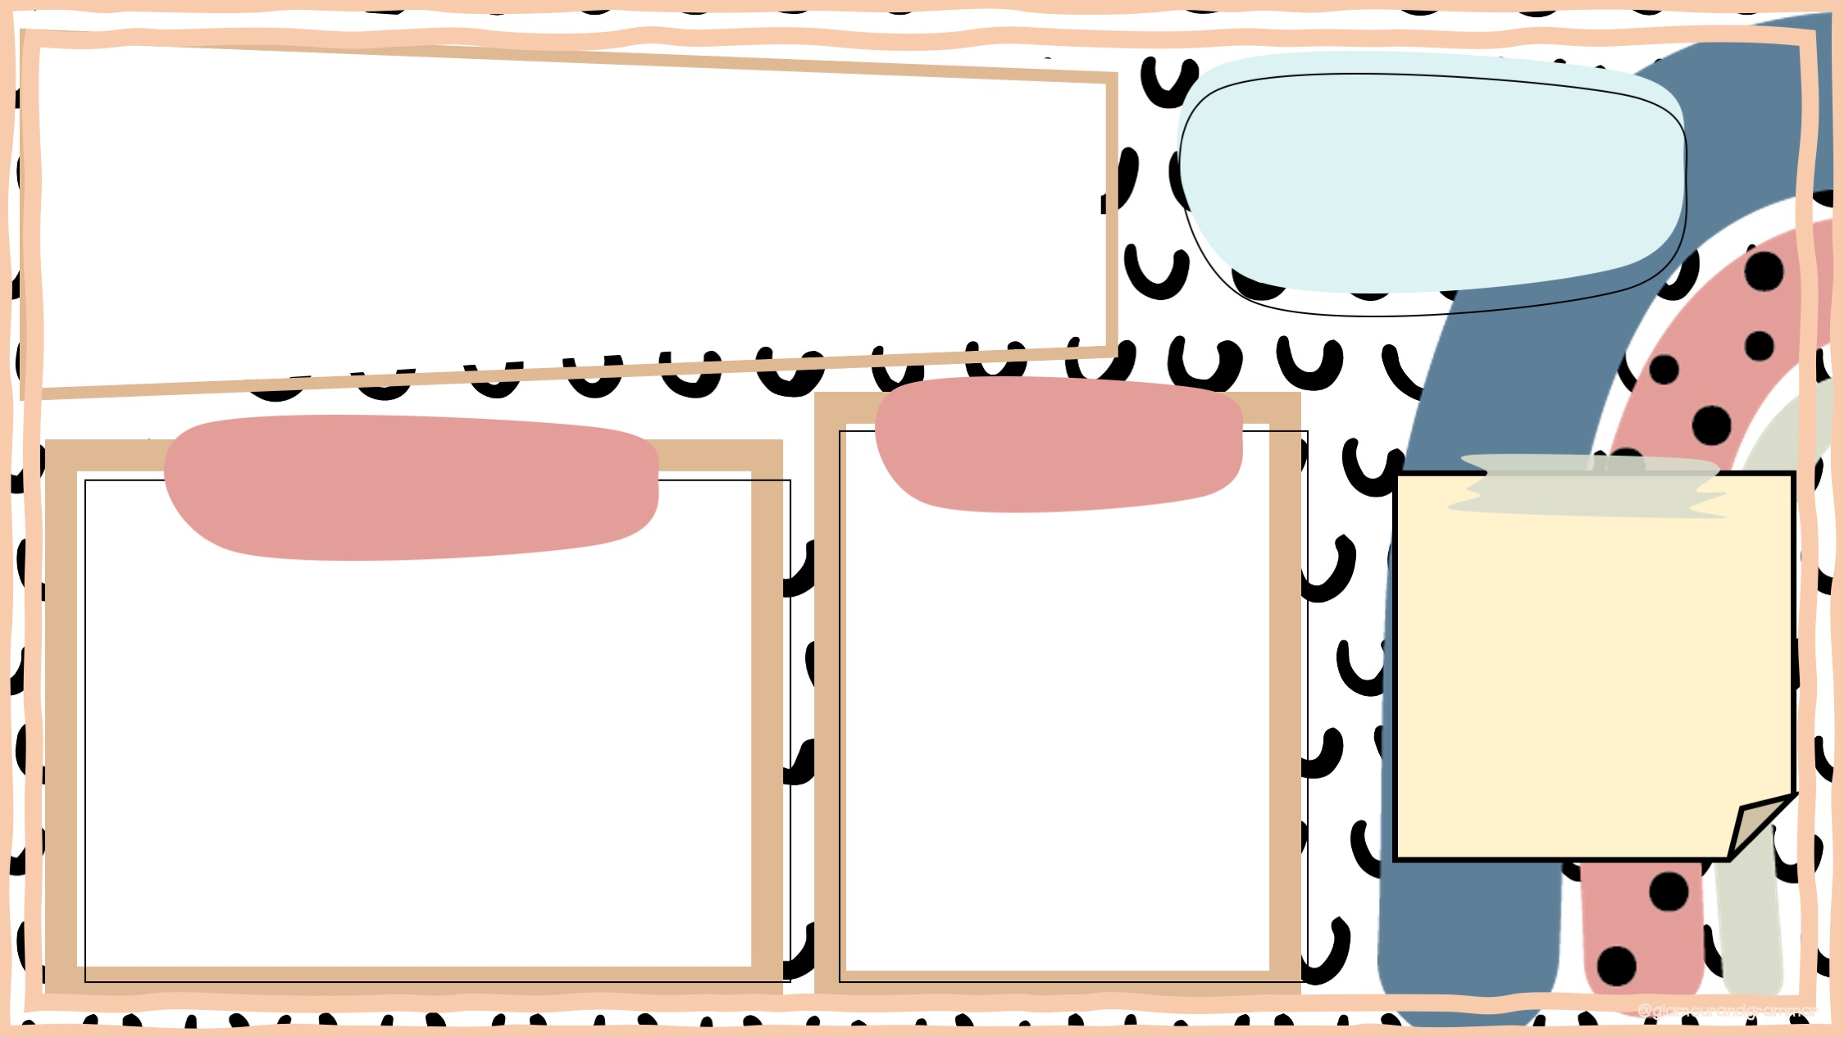
Parties & Events
Celebrate!!!
Birthdays
Holidays
We are allowing guests to join us for lunch on Fridays!
Thanksgiving
Come FEAST with us!
Christmas
Join us for our Christmas party!
Valentines
For students only.
You may bring cupcakes (store-bought), treats, and goody bags.

Slide 8
Parties & Events
Celebrate!!!
Birthdays
Holidays
We are allowing guests to join us for lunch on Fridays!
Thanksgiving
Come FEAST with us!
Christmas
Join us for our Christmas party!
Valentines
For students only.
You may bring cupcakes (store-bought), treats, and goody bags.

Slide 9

Binders
Check EACH night!
Newsletters
Homework
The newsletters are your Kindergarten Survival Guides! Read them each week and refer to them for homework, wordlist words, news, reminders, math skills and the story! Newsletters will come home every Friday.
Homework is very important!
reinforces skills learned during class
- helps improve memory of material
ELA: The week's letter and/or sound, skills, sight words, is on the newsletter. Please read with your student each night. Review any skills addressed in school work, homework, and on the newsletters.
Math: iReady sheet, school work brought home, and skills on the newsletter.
READ, READ, READ!!!

Slide 10

Academics
Check newsletters for dates of tests!
Progress reports and report cards are sent home every nine weeks.
End of Year Expectations
read 20 cwpm
add and subtract (numbers to 10)
know shapes (2d &3d), colors, patterns, sight words
show grade appropriate handwriting
Goals
December -identify ALL letters/sounds
Feb. -Read 10 correct words per minute
March -Read 15 correct words per minute
April -read 20 correct words per minute

Slide 11

Contact Me!
jmonts@pearlk12.com
601-932-7976
pearlk12.com/Domain/87

